Slide 1

Introduction
Who am I Paul Barrick
What I do
Application Development
Where to find me online
twitter / github
@peb7268 / github.com/peb7268

Slide 2
Why Am I here
http://bit.ly/IpZbco

Slide 3
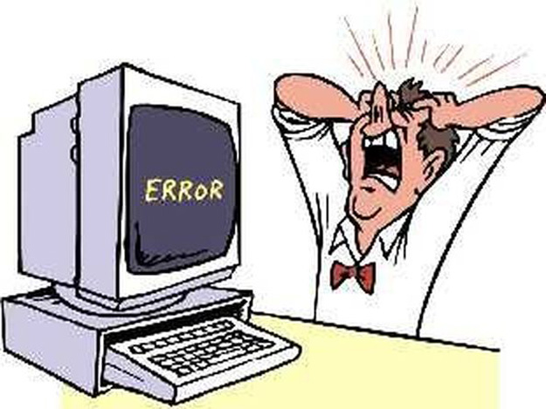
The life of a new developer.

Slide 4

What we all want to be:

Slide 5
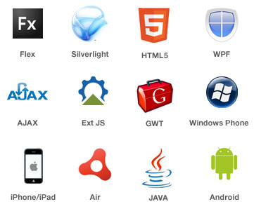
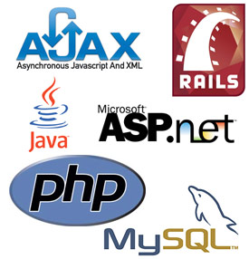
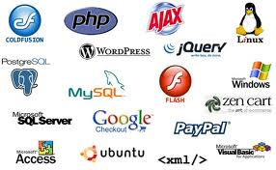
How do we get there?

Slide 6

History
The old web: Dreamweaver, web masters, FTP, tables based layouts, a little jQuery goes a long way.
  The dreamweaver approach: dreamweaver and its cousin frontpage.
  FTP: Oops I did it again.
  Table based layouts
  I have reached nerd knowledge nirvana. Why learn more?
  The waterfall development methodology.

Slide 7
No more export to html / wysiwyg
HTML vs HTML5:
  What do I need to know to write an HTML5 App?
CSS is not an advanced skill.
  Its a basic fundamental. CSS & HTML is to developers as breathing should be to a human.

Slide 8
CSS3
What is CSS3
  Built on top of CSS2
  adds things like rounded corners, multiple backgrounds, drop shadows, new font styles, animations, transitions, media queries. ect..

Slide 9
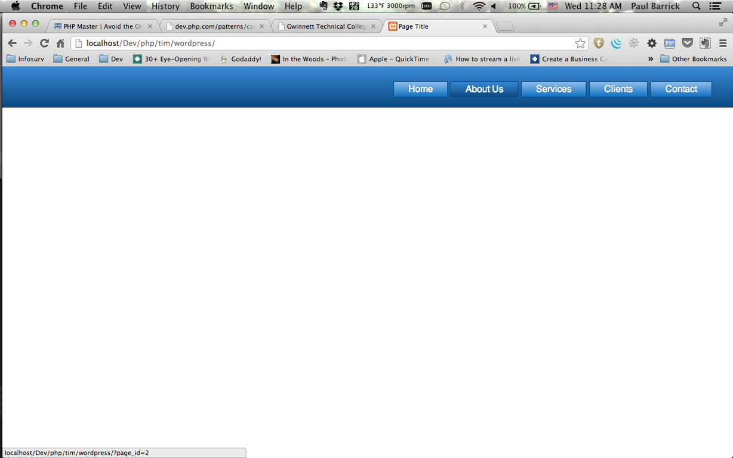
Example

Slide 10
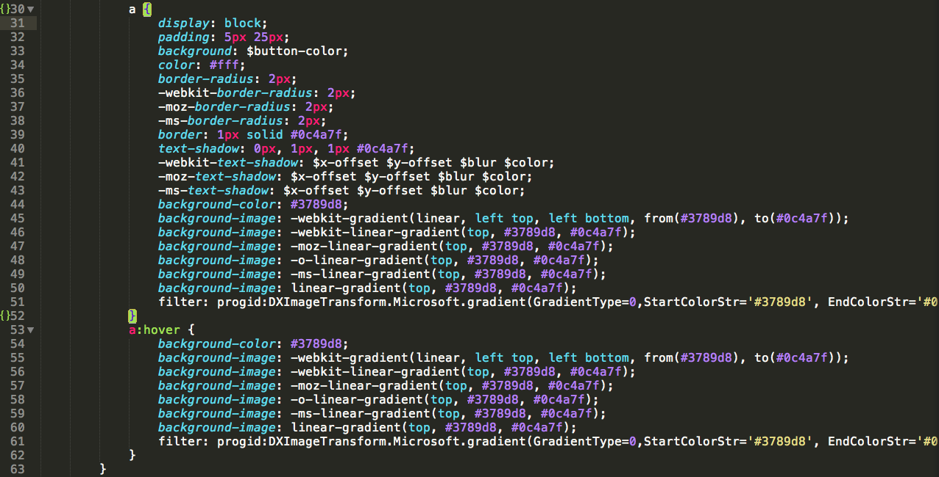
Normal CSS

Slide 11
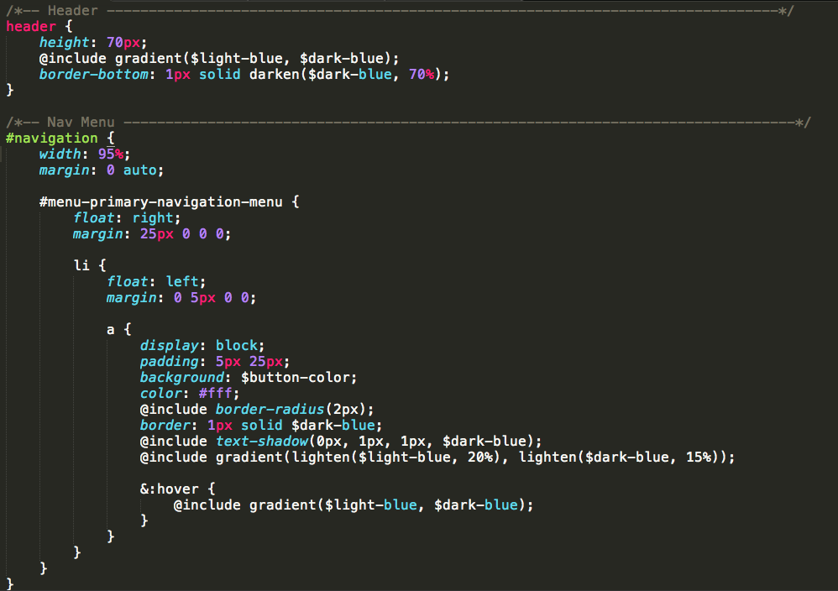
SASS Syntax

Slide 12
SASS
Normal CSS:
  63 lines
  Very verbose
  many places for errors
  lots of duplication
SASS Style
  36 lines
  variables, reusable code blocks, ect..

Slide 13
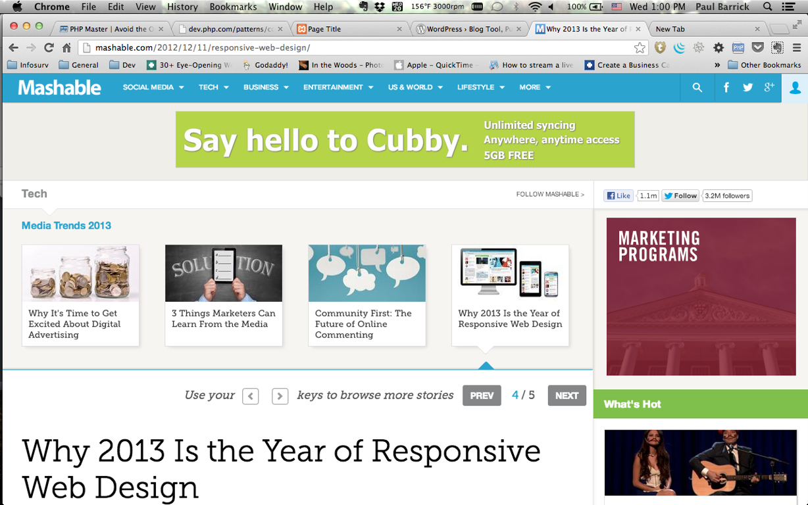
Responsive Design
One Code base to rule them all
Text

Slide 14
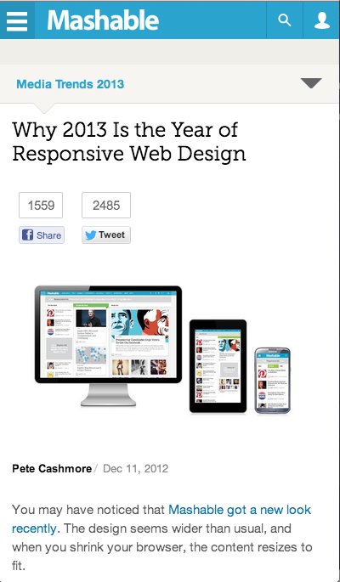
The mobile version

Slide 15
The new reality ( of JS )
What used to be considered as advanced is now considered a basic.
  We are required to know a myriad of technology. Not just front or back.
  The essential jQuery: one script to rule them all.
  Frameworks, backbone, require.js, mustache.
backbonejs.org
requirejs.org
handlebarsjs.com

Slide 16
JavaScript Rules The World ( at least online )
As of Aug 2012 half of all sites use jQuery. ( sitepoint )
Almost all major products / services you use online heavily rely on javascript.
The modern web is the result of ajax
Growing power and complexity requires new solutions to manage the codebase.

Slide 17
Frameworks to the rescue
Need for better code structure: Backbone.
Need for code modularity: requirejs
Cleaner client side templating: enter handlebars.

Slide 18
SPA’s: Single Page Apps
What is an SPA?
  central control
  routing
  modular design
Who uses an SPA structure?
  Gmail
  Google Maps
  Linkedin
  Facebook

Slide 19
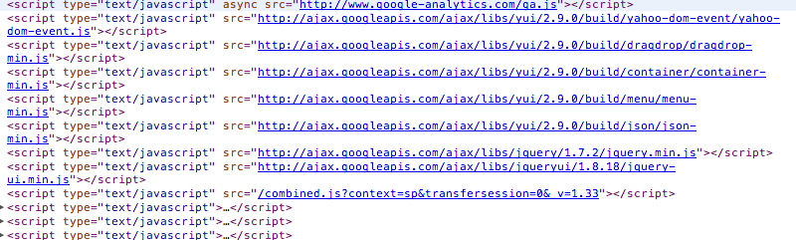
Example: AITP Gwinnett

Slide 20
TDD & BDD
Test Driven Development is the process of writing code that evaluates if your code does what it’s supposed to do: before you write any actual code.
You make the test fail. Then you make it pass, then you refactor
Javascript TDD: jasmine, qunit, mocha.

Slide 21
Server Side
PHP, .NET, Ruby, Node
PHP: WordPress, Laravel, codeigniter, cakephp, zend
Ruby: rails
Node: express

Slide 22
PHP5 & The renaissance
Autoloading
Namespaces
Composer

Slide 23
WordPress
2011: WordPress powers 22% of the web.
Of all CMS’s in use WordPress runs 55% of them.
2012: Wordpress runs 60 million websites ( Forbes )

Slide 24
Laravel / Frameworks
Laravel
  RAD Software development.
  Api creation
  CRUD Scaffolding
  Database Migrations
  TDD built in PHPUnit.

Slide 25
How code management has changed
The means to get a file from point a to point b.
How we connected to manage code
In use today behind the scenes.
Today FTP is rarely used for code management & editing.

Slide 26



FTP Is dead

Slide 27

Long Live GIT( and other scms )

Slide 28
What is GIT
GIT is a decentralized SCM ( source control manager )
GIT allows teams of people to work on the same code base simultaneously without fear of overwriting each others work and with out conflicts.
It allows for limitless experimenting without the fear of messing up your working code base.
GIT is like the government, it keeps a history of all you do. Revisions.

Slide 29
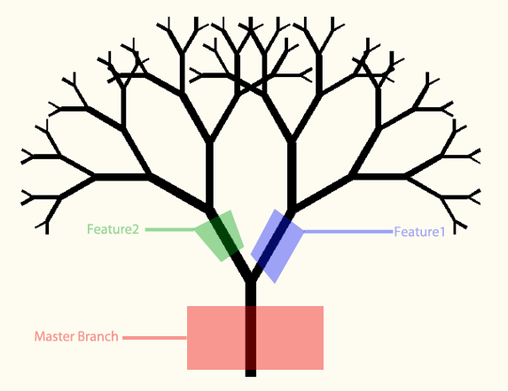
GIT Structure

Slide 30
GITHUB
github.com
Social Coding
Learn by doing
Required for many jobs.
Amazing tutorials on how to get going w GIT.
Markdown

Slide 31
The Terminal
Why use it?
    It’s much faster
    You can do everything there
    VIM, TMUX, PHPUnit, TDD, Ruby, Bash automation, SSH, SCP

Slide 32
Resources
net.tutsplus.com
jspro.com
phpmaster.com
codeschool.com

